Slide 1

AgriVision
Syed Wameez Ahmed 160923733067
Mohd Zaid Khan 160923733073
Mohammed Abdul Muheed 160923733076
Ali Abbas Masum Khoja 160923733101

Slide 2
Introduction
🌱 WHAT IT IS
• An intelligent agricultural platform integrating IoT, AI and machine learning.
• Monitors crop health and environmental conditions using field sensors
• Detects pest activity and predicts potential crop disease risks.
• Monitors post-harvest storage conditions to reduce crop deterioration.
⚡ WHAT IT DOES
• Collects real-time agricultural data from IoT sensors.
• Uses computer vision to identify and count agricultural pests.
• Predicts disease risks using environmental conditions.
• Monitors temperature, humidity and grain moisture in storage facilities.
• Generates alerts and supports automated storage ventilation.
👥 WHO IT IS FOR
• Farmers and agricultural producers.
• Agricultural cooperatives and FPO’s
• Grain storage operators and warehouse managers.
KEY IMPACT HIGHLIGHTS: Early Threat Detection | Reduced Crop Loss | Smart Storage Management

Slide 3
Problem Statement
01 | Delayed Pest Detection
Farmers often depend on manual field inspections to identify pest infestations. Increasing pest populations may remain unnoticed significant crop damage occurs.
🛑 Key Issue: Lack of continuous pest monitoring and early alerts
02 | Crop Disease Identification
Environmental conditions such as temperature, humidity and leaf wetness can favor disease development. Farmers may not identify these risks before visible symptoms appear.
🛑 Key Issue: Limited predictive disease monitoring
03 | Post-Harvest Storage Losses
Improper temperature, humidity and grain moisture conditions can encourage fungal growth, insect activity and deterioration during storage.
🛑 Key Issue: Insufficient monitoring of storage environments
04 | Lack of Automated Decision Support
Agricultural sensor readings are not always converted into useful recommendations or automated actions.
🛑 Key Issue: Farmers lack an integrated monitoring and alert system

Slide 4
Project Objectives
1
SMART PEST DETECTION
Develop a camera-based monitoring system to identify, classify and count agricultural pests.
2
EARLY DISEASE WARNING
Analyze environmental sensor data to identify conditions favorable for crop diseases.
3
SMART STORAGE MONITORING
Monitor storage temperature, relative humidity, grain moisture and CO levels.
4
AI-BASED RISK PREDICTION
Develop machine-learning models to estimate pest, disease and storage deterioration risks.
5
AUTOMATED FARMER ALERTS
Provide timely notifications and control actions through an integrated agricultural platform.

Slide 5
Existing Solutions & Critical Limitations
🏛️ EXISTING METHODS & WORKFLOW
• Manual Pest Inspection: Farmers physically inspect crops to identify insect infestations.
• Visual Disease Detection: Crop diseases are identified through visible symptoms and expert observation.
• Conventional Storage Monitoring: Temperature and humidity are checked periodically using separate instruments.
• Bsic IoT Monitoring: Sensor-based systems collect environmental data and display readings.
⚠️ CRITICAL LIMITATIONS
✖ Manual Inspection: Requires time and labour for continuous field monitoring.
✖ Reactive Disease Detection: Visible symptoms may appear after disease development has started.
✖ Limited Pest Tracking: Traditional traps do not always provide automatic pest counting and historical analysis.
✖ Storage Monitoring: Periodic measurements may fail to identify changing environmental conditions.
CONCLUSION: Existing methods provide individual monitoring capabilities, but there is a need for an integrated system combining IoT sensing, AI-based prediction and automated responses

Slide 6
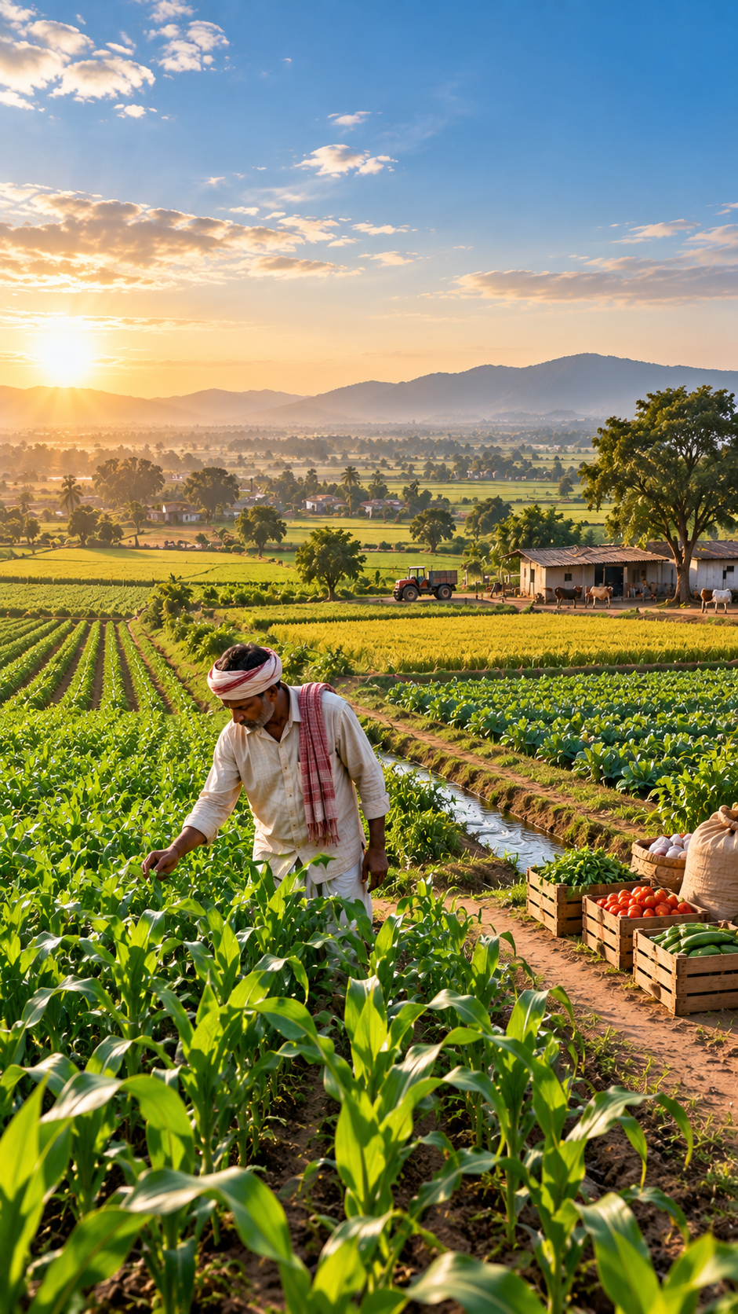
Proposed Solution: AgriVision
✓ Smart Pest Monitoring
Uses cameras to capture images of insects from agricultural traps.
✓ Disease Early Warning
Collects temperature, humidity, rainfall and leaf-wetness data and uses machine learning to identify environmental conditions favorable for crop diseases.
✓ Smart Post-harvest Storage
Tracks temperature, humidity, grain moisture and CO2 and identifies potentially harmful storage conditions.
✓ Government Schemes & Subsidies
Provides farmers with access to government agricultural schemes, subsidy information and application details through a centralized platform.

Slide 7
System Workflow
STEP 1
STEP 2
STEP 3
STEP 4
STEP 5
STEP 6
Farmer Registeration
Farmer registers and selects crop type, farm location and agricultural fields.
IoT Sensor Deployment
Sensors are installed across selected field zones to collect environmental and soil measurements.
Pest & Disease Monitoring
Cameras capture pest images while environmental sensors continuously collect field conditions.
AI/ML Analysis
Computer vision identifies pests, while ML models estimate pest & disease risks.
Harvest & Storage Monitoring
After harvesting, storage sensors collect temperature, humidity, grain moisture and CO2 measurements.
Alerts & Automation
The platform generates alerts & activates suitable storage-control devices when configured conditions are met.
➔
➔
➔
➔
➔

Slide 8
Key System Features
1. Real-time Environmental Monitoring
Collects temperature, humidity, rainfall and soil conditions using IoT sensors.
2. AI-based Pest Detection
Identifies and counts selected agricultural pests through camera images.
3. Crop Disease Risk Prediction
Analyzes environmental conditions to identify potential disease development.
4. Pest Population Tracking
Maintains historical pest counts and identifies increasing infestation trends.
5. Smart Storage Monitoring
Continuously tracks temperature, humidity and grain moisture conditions.
6. Spoilage Risk Assessment
Analyzes storage conditions and identifies potential deterioration risks.
7. Autoamted Ventilation Control
Controls fans through relays based on configured storage-management rules.
8. Farmer dashboard & Alerts
Displays sensor readings, risk levels, historical data and important notifications.

Slide 9
Before & After Comparison
❌ BEFORE: CONVENTIONAL WORKFLOW
• Manual Pest Inspected
• Disease identifies after symptoms
• No continuous pest tracking
• Periodic storage inspection
• Manual ventilation control
• Separate monitoring tools
✓ AFTER: WITH AGRIVISION PLATFORM
• Camera-based pest monitoring
• Environmental disease-risk alerts
• Historical pest population analysis
• Continuous storage monitoring
• Rule-based automated ventilation
• Integrated agricultural dashboard
OVERALL IMPROVEMENT: From manual and reactive agricultural monitoring to an integrated, predictive and data-driven crop protection and storage management system

Slide 10
Technology Stack & Architecture
HARDWARE & IoT
ESP32, SHT31/SHTT35, Capacitive soil moisture sensor, leaf wetness sensor, raspberry Pi camera, NDIR CO2 Sensor, grain moisture meter, relay module
COMMUNICATION
MQTT, Wifi/LoRa, Iot Gateway
BACKEND & DATABASE
PostgreSQL, Python & FastAPI, MQTT Broker
AI & ML
YOLO, CNN, Random forest/XGBoost, Pandas & Scikit-learn
FRONTEND & VISUALIZATION
React-Native, Expo, React, Chart libraries

Slide 11
THANK YOU

